Slide 1
Tutorial 1
Linear algebra recap

Slide 2
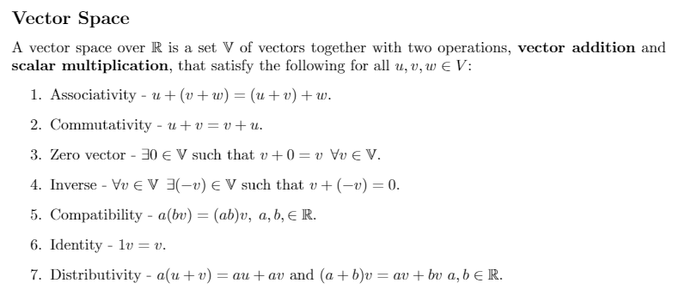
Vector space

Slide 3
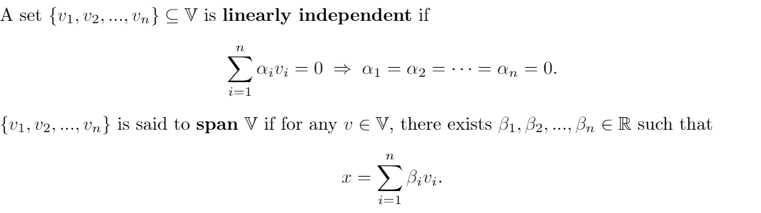
Linear independence and Span

Slide 4
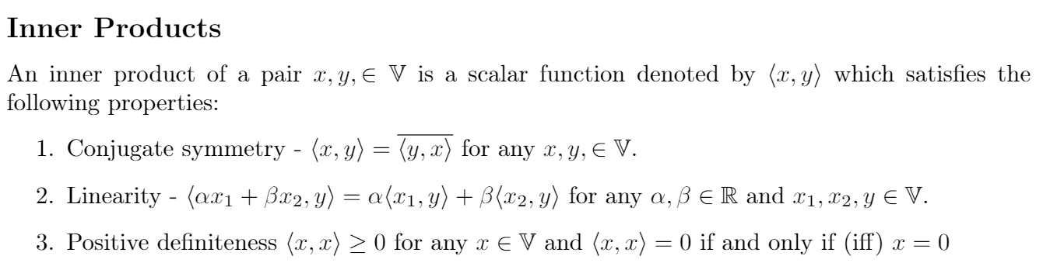
Inner product

Slide 5
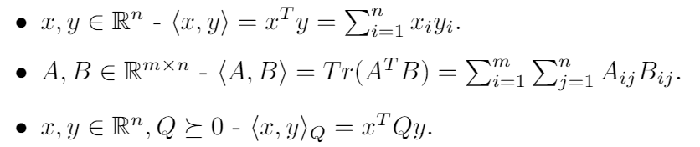
Inner product examples

Slide 6
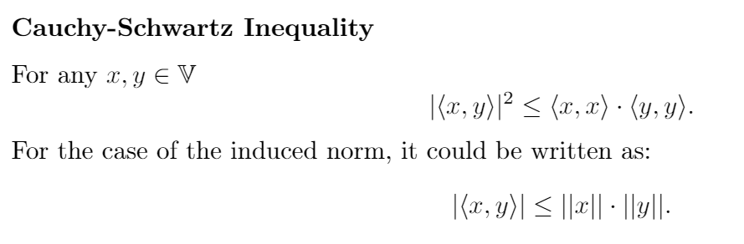
Cauchy-Schwartz Inequality

Slide 7
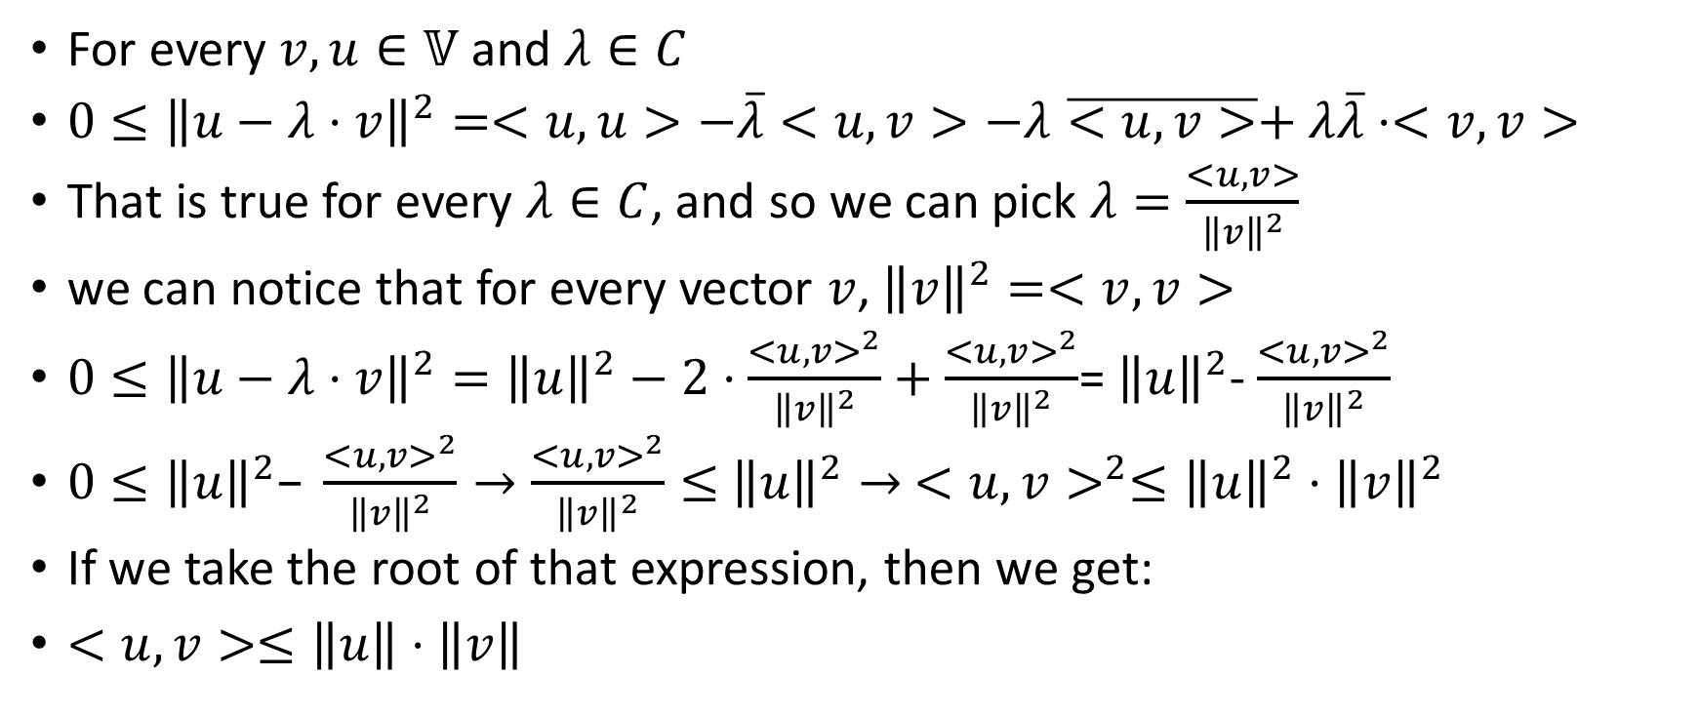
Proof:
For every $v,u∈𝕍$ and $λ∈C$
$0≤{\left\|u−λ⋅v\right\|}^{2}=<u,u>−\overline{λ}<u,v>−λ\overline{<u,v>}+λ\overline{λ}⋅<v,v>$
That is true for every $λ∈C$, and so we can pick $λ=\frac{<u,v>}{{\left\|v\right\|}^{2}}$
we can notice that for every vector $v$, ${\left\|v\right\|}^{2}=<v,v>$
$0≤{\left\|u−λ⋅v\right\|}^{2}={\left\|u\right\|}^{2}−2⋅\frac{<u,v>^{2}}{{\left\|v\right\|}^{2}}+\frac{<u,v>^{2}}{{\left\|v\right\|}^{2}}$= ${\left\|u\right\|}^{2}$- $\frac{<u,v>^{2}}{{\left\|v\right\|}^{2}}$
$0≤{\left\|u\right\|}^{2}\text{−} \frac{<u,v>^{2}}{{\left\|v\right\|}^{2}}→\frac{<u,v>^{2}}{{\left\|v\right\|}^{2}}≤$ ${\left\|u\right\|}^{2}→$ $<u,v>^{2}≤{\left\|u\right\|}^{2}⋅{\left\|v\right\|}^{2}$
If we take the root of that expression, then we get:
$<u,v>≤\left\|u\right\|⋅\left\|v\right\|$

Slide 8
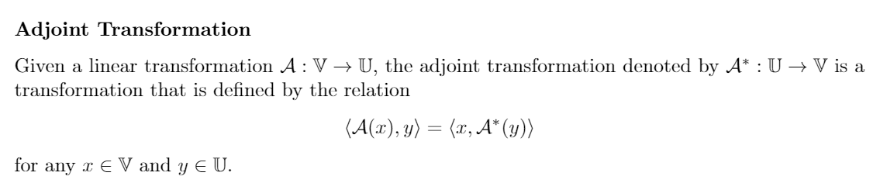
Adjoint

Slide 9
Some fun questions ☺

Slide 10
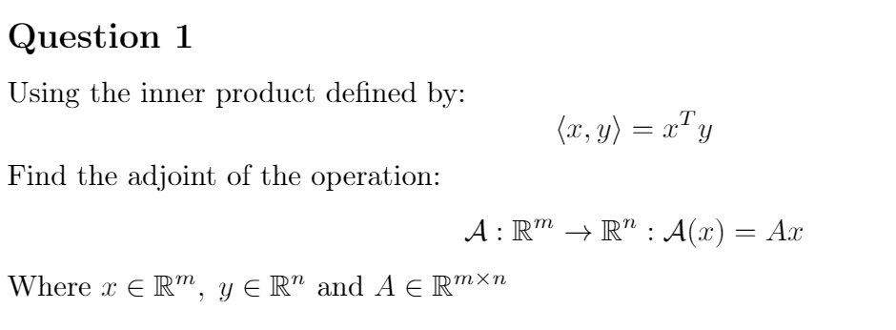

Slide 11
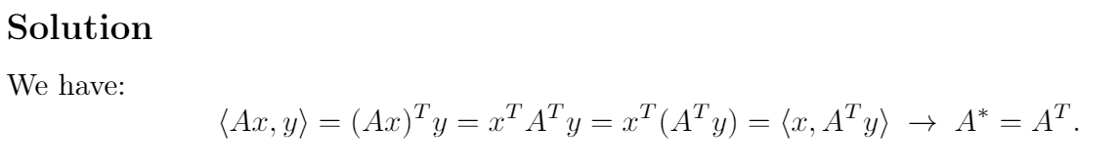

Slide 12
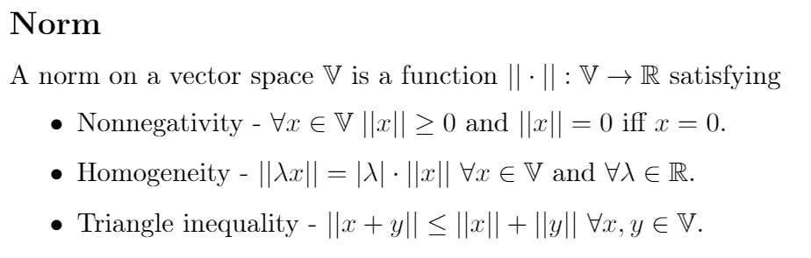

Slide 13
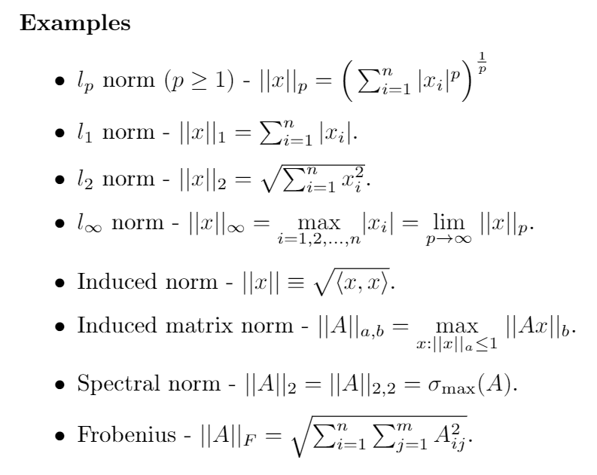

Slide 14
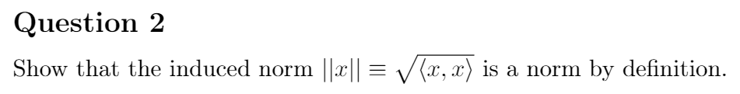

Slide 15
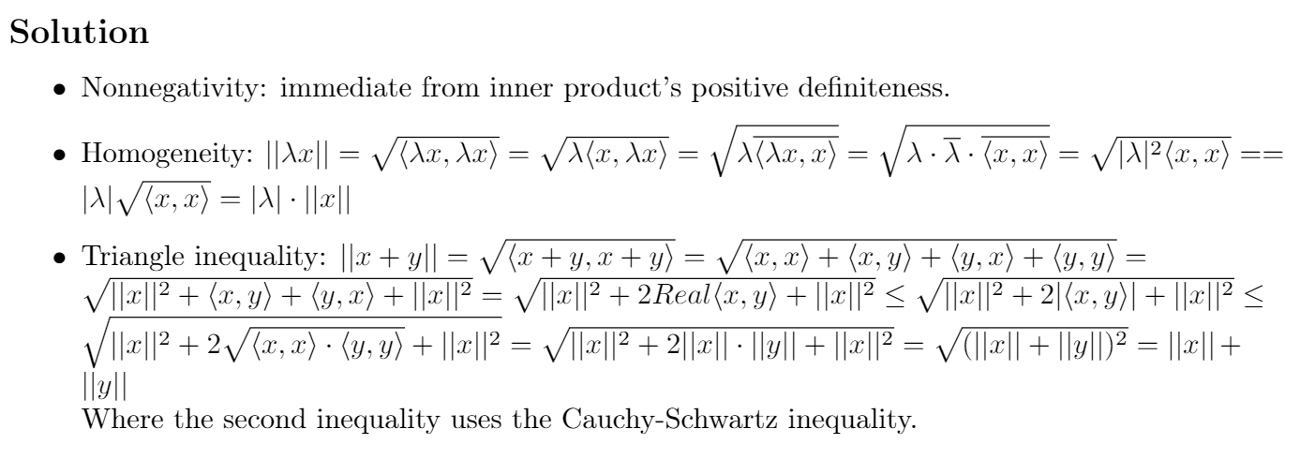

Slide 16
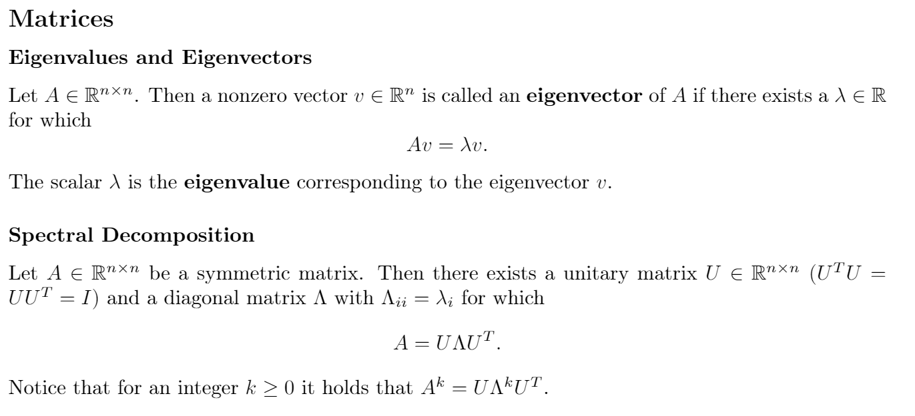

Slide 17
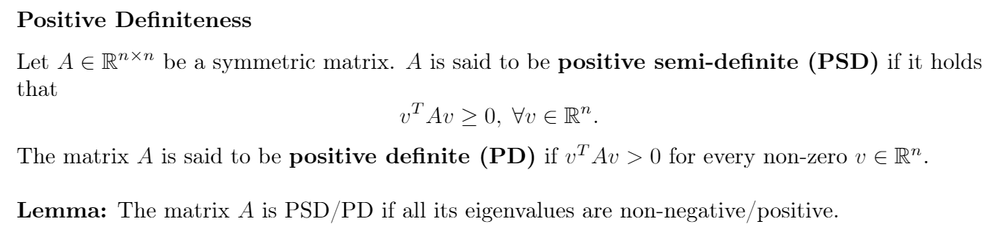

Slide 18
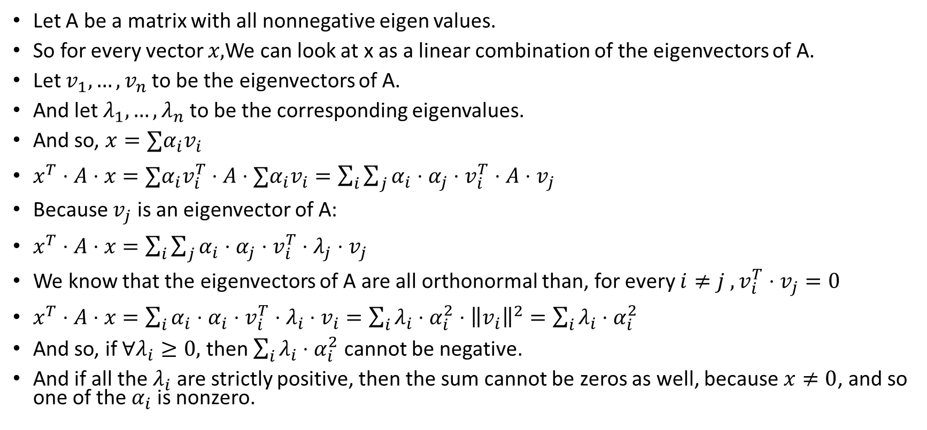
Proof of the lemma
Let A be a matrix with all nonnegative eigen values.
So for every vector $x,$We can look at x as a linear combination of the eigenvectors of A.
Let $v_{1},…,v_{n}$to be the eigenvectors of A.
And let $λ_{1},…,λ_{n}$to be the corresponding eigenvalues.
And so, $x=∑α_{i}v_{i}$
$x^{T}⋅A⋅x=∑α_{i}v_{i}^{T}⋅A⋅∑α_{i}v_{i}=\sum_{i}{\sum_{j}{α_{i}⋅α_{j}⋅v_{i}^{T}⋅A⋅v_{j}}}$
Because $v_{j}$ is an eigenvector of A:
$x^{T}⋅A⋅x=\sum_{i}{\sum_{j}{α_{i}⋅α_{j}⋅v_{i}^{T}⋅λ_{j}⋅v_{j}}}$
We know that the eigenvectors of A are all orthonormal than, for every $i≠j , v_{i}^{T}⋅v_{j}=0$
$x^{T}⋅A⋅x=\sum_{i}{α_{i}⋅α_{i}⋅v_{i}^{T}⋅λ_{i}⋅v_{i}=\sum_{i}{λ_{i}⋅α_{i}^{2}⋅{\left\|v_{i}\right\|}^{2}=\sum_{i}{λ_{i}⋅α_{i}^{2}}}}$
And so, if $∀λ_{i}≥0,$ then $\sum_{i}{λ_{i}⋅α_{i}^{2}}$ cannot be negative.
And if all the $λ_{i}$ are strictly positive, then the sum cannot be zeros as well, because $x≠0$, and so one of the $α_{i}$ is nonzero.

Slide 19
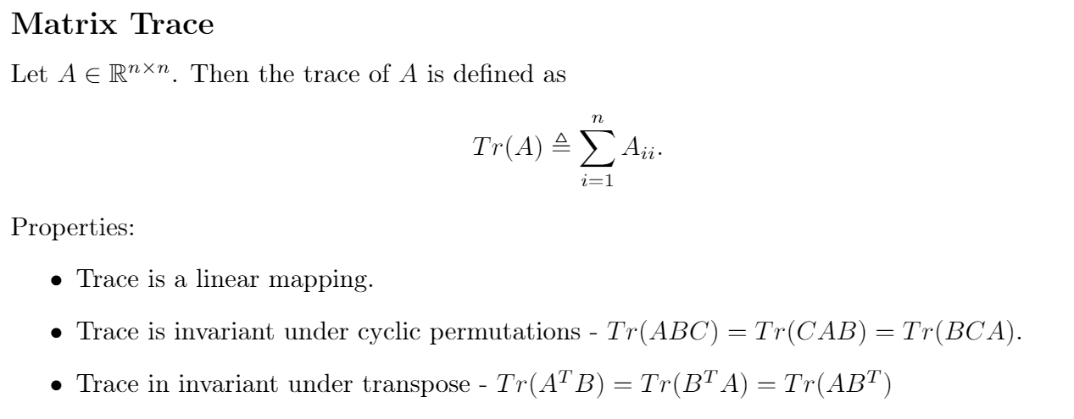

Slide 20
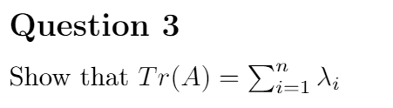

Slide 21
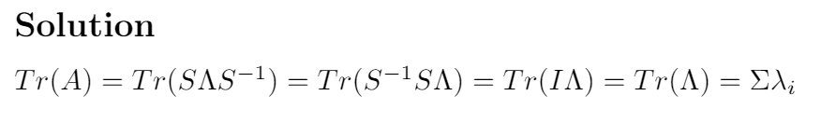

Slide 22
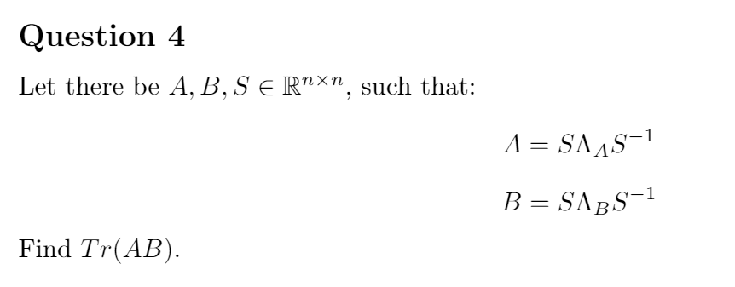

Slide 23
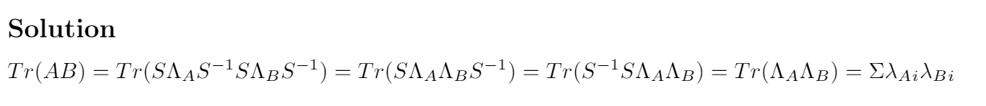

Slide 24
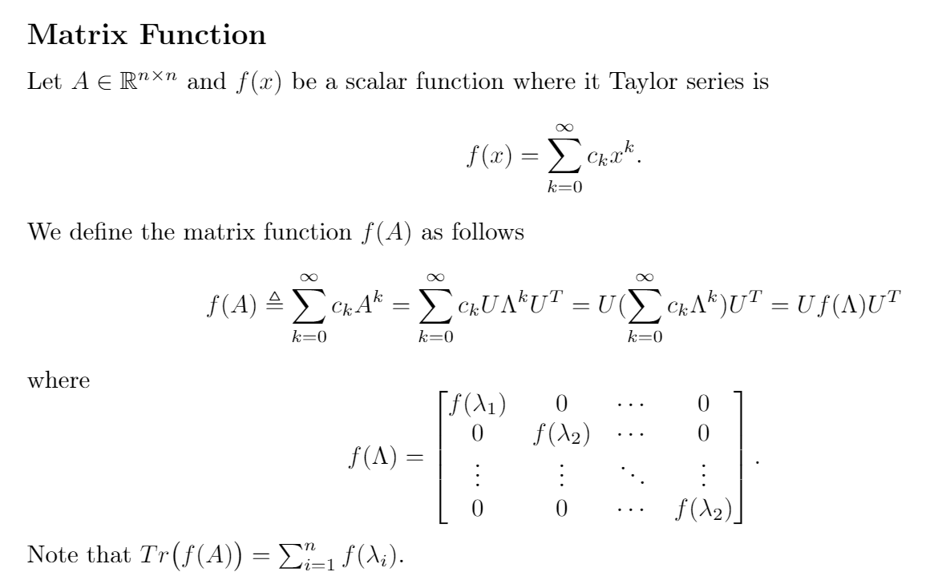

Slide 25
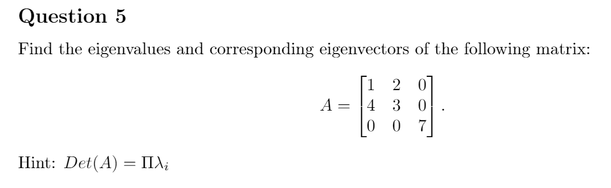

Slide 26
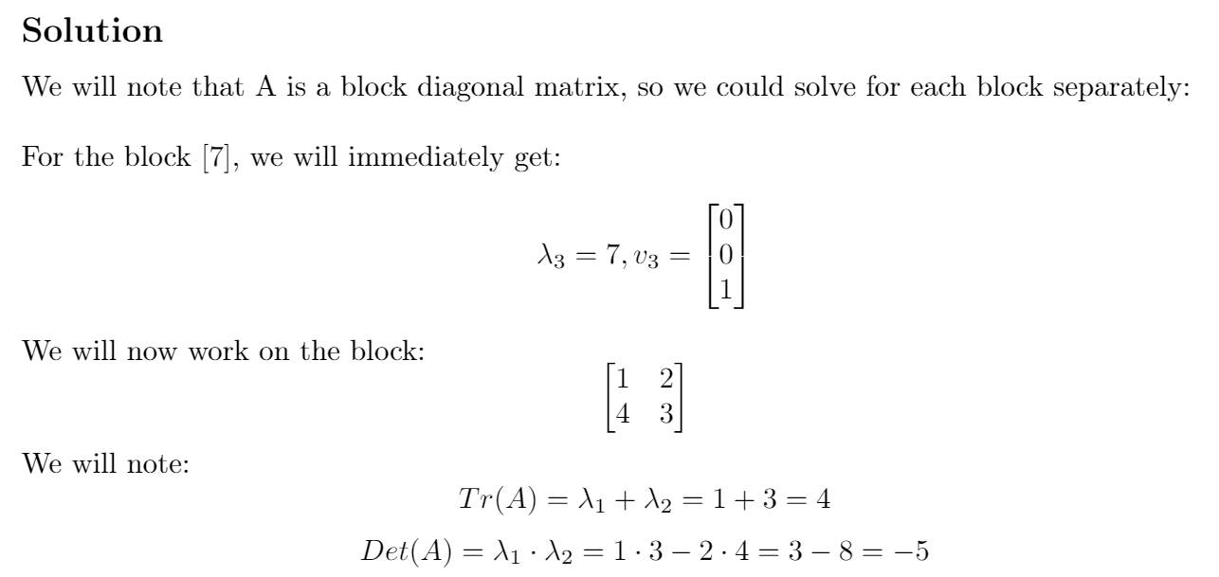

Slide 27
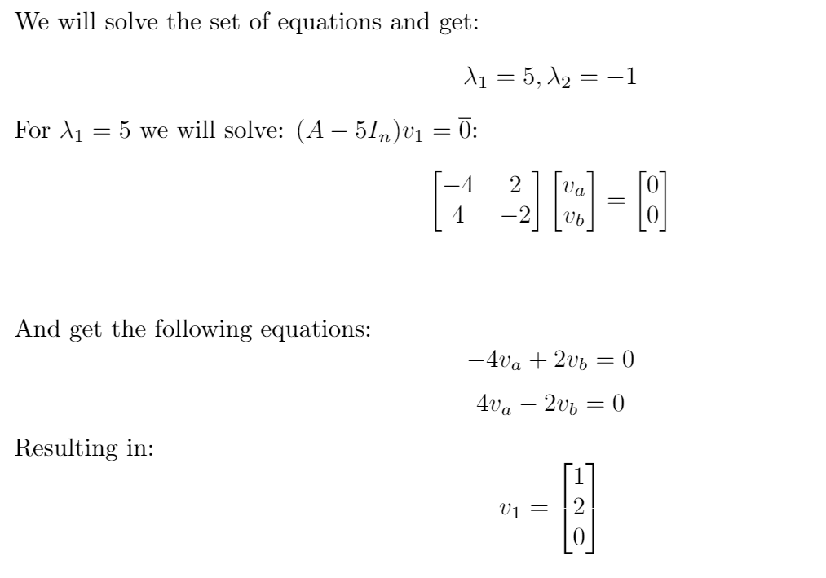

Slide 28
